Slide 1
Lockup - Sword Hackathon Challenge
Developed and Presented by Ash Jewell, Adam Rowe & Archie Houghton

Slide 2
What does this genre suffer from?

Slide 3
What is Lockup?
The main trope of escape games having you attempt to breach captivity and 'escape'.
We are choosing to subvert this by flipping the script; you lock yourself in to escape from those coming after you

Slide 4

Why VR?
VR is a rapidly growing industry that is becoming more accessible everyday with dropping prices and relatively easy to understand development tools.

Slide 5

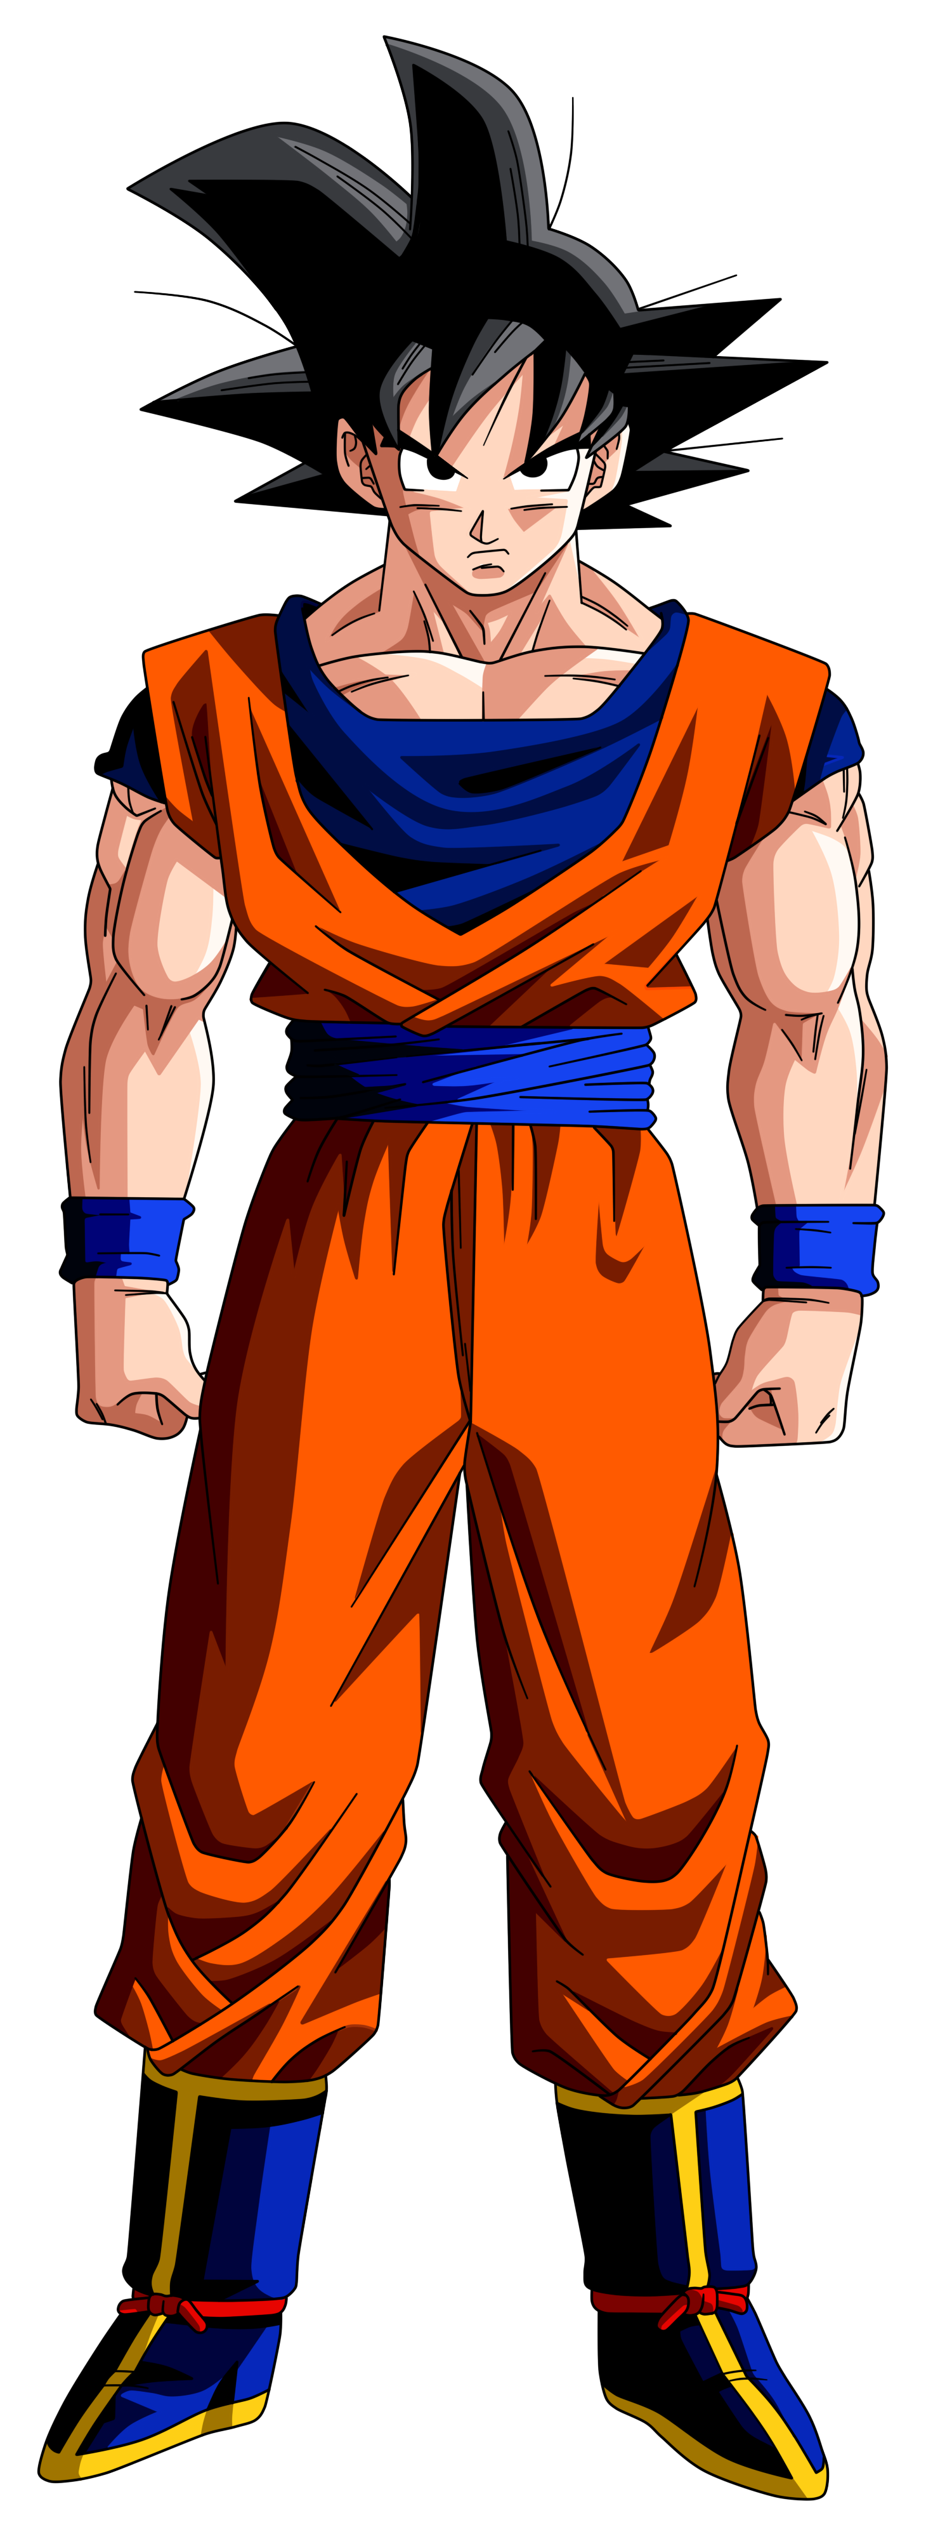
Our Theme
You must escape through the orchard,
solving various puzzles before the time runs out...
...lest you be consumed by the forest.

Slide 6
How About a demonstration?

Slide 7


Slide 8
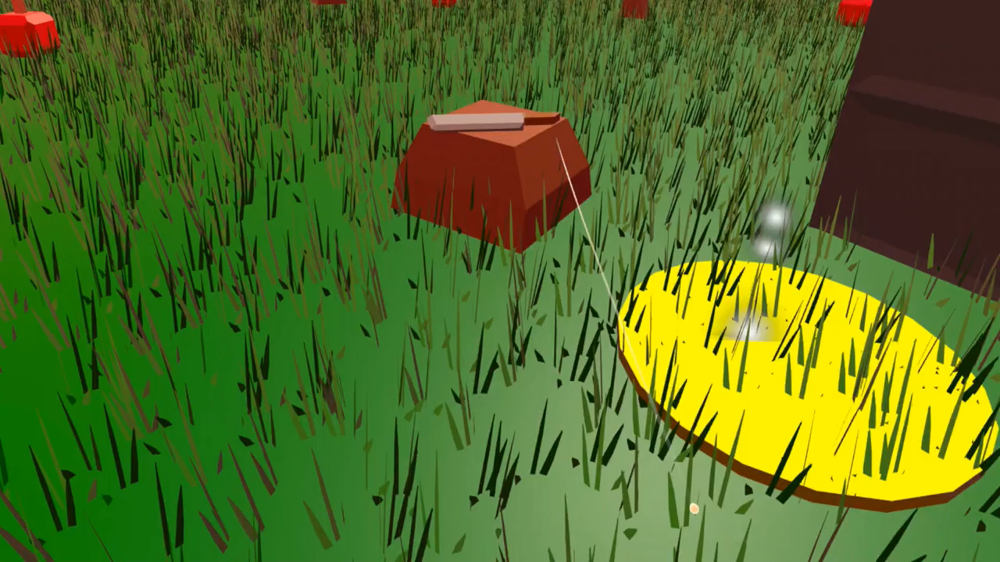

Slide 9


In Conclusion...
Please vote for us

